Slide 1








STRATEGIC
TIC TAC TOE
BUILT IN C USING RAYLIB

Slide 2
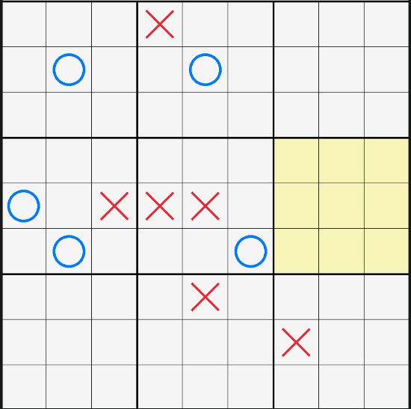

WHAT IS STRATEGIC TIC TAC TOE?
TIC TAC TOE INSIDE TIC TAC TOE
INSTEAD OF A SIMPLE 3*3 GRID, THE GAME IS NESTeD. EVERY CELL IN THE BIG BOARD CONTAINS A FULLY FUNCTIONAL SMALL BOARD.
THE Large BOARD: 9 TOTAL cells
THE Smaller BOARDS: 81 TOTAL cells
THE GOAL: WIN THREE SMALL BOARDS IN A ROW TO CLAIM THE BIG BOARD.
THE FORCED MOVE RULE
YOUR MOVE DETERMINES WHERE YOUR OPPONENT MUST PLAY NEXT.
IF YOU PLAY IN THE BOTTOM-LEFT CELL OF ANY SMALL BOARD, YOUR OPPONENT IS FORCED TO TAKE THEIR NEXT TURN IN THE BOTTOM-LEFT BOARD OF THE LARGE GRID.

Slide 3
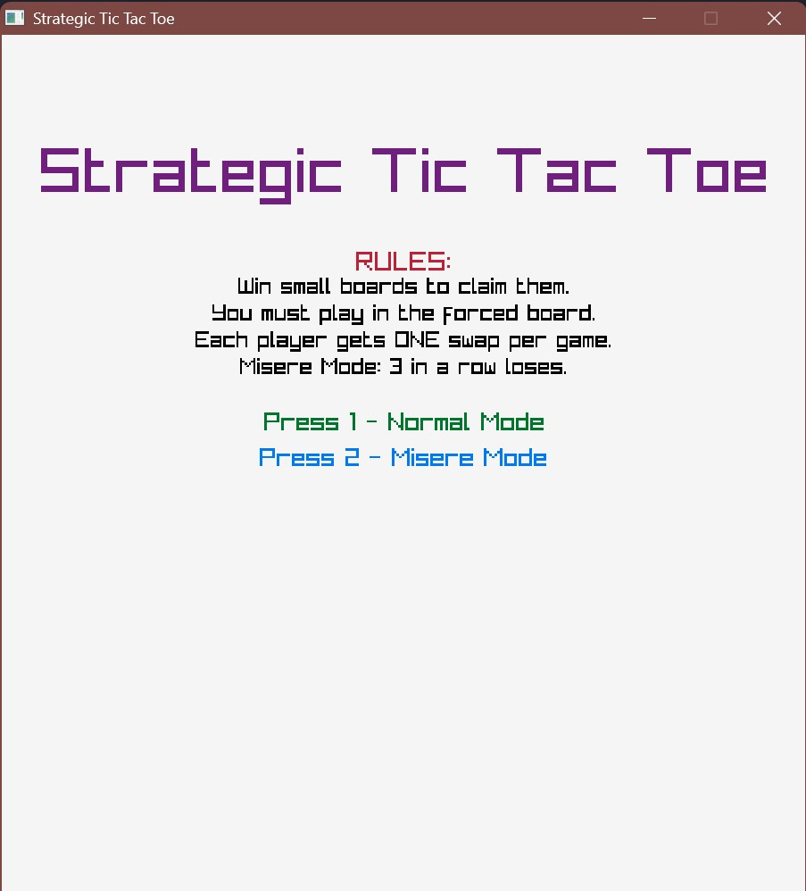


HOW DOES THIS GAME WORK?
AlGorIthm

Slide 4
INITIALIZATION & STRUCTURE
ALGORITHM: GAME SETUP
CREATE SB[3][3][3][3] (9 SMALL BOARDS) AND BB[3][3] INITIALIZE PLAYERS, FLAGS, AND GAME VARIABLES.
WHILE WINDOW OPEN:
HANDLE MENU / PLAYING / SWAP STATE
PROCESS MOVE
UPDATE BOARD & CHECK WINNER
DRAW EVERY frame

Slide 5
TURN LOGIC
ALGORITHM: PLAYER TURN
ON MOUSE CLICK, DETERMINE SMALL BOARD AND CELL POSItIon.
ValIdate move (freeMove OR forced) IF cell IS empty.
Place mark and check small board wIn/draw → update bIg board.
Set next forced board; enable FREEMOVE IF board Is occupIed
CHECK BIG BOARD FOR WIN (NORMAL or MISÈRE) OR DRAW.
IF GAME NOT OVER → SWITCH PLAYER.

Slide 6
SWAP LOGIC & GAME STATES
ALGORITHM: SWAP SYSTEM
If a player wins a small board and swap not used → enter SWAP state.
PLAyeR SELECTS ANOTHER SMALL BOARD → SWAP BIG BOARD RESULTS AND SMALL BOARD CONTENTS.
MARK SWAP AS USED AND SET FREEMOVE = TRUE.
RETURN TO PLAYING STATE AND SWITCH PLAYER.
IF GAMEOVER = TRUE → DISPLAY WINNER OR DRAW.
PRESS R TO RESTART OR M TO RETURN TO MENU.

Slide 7
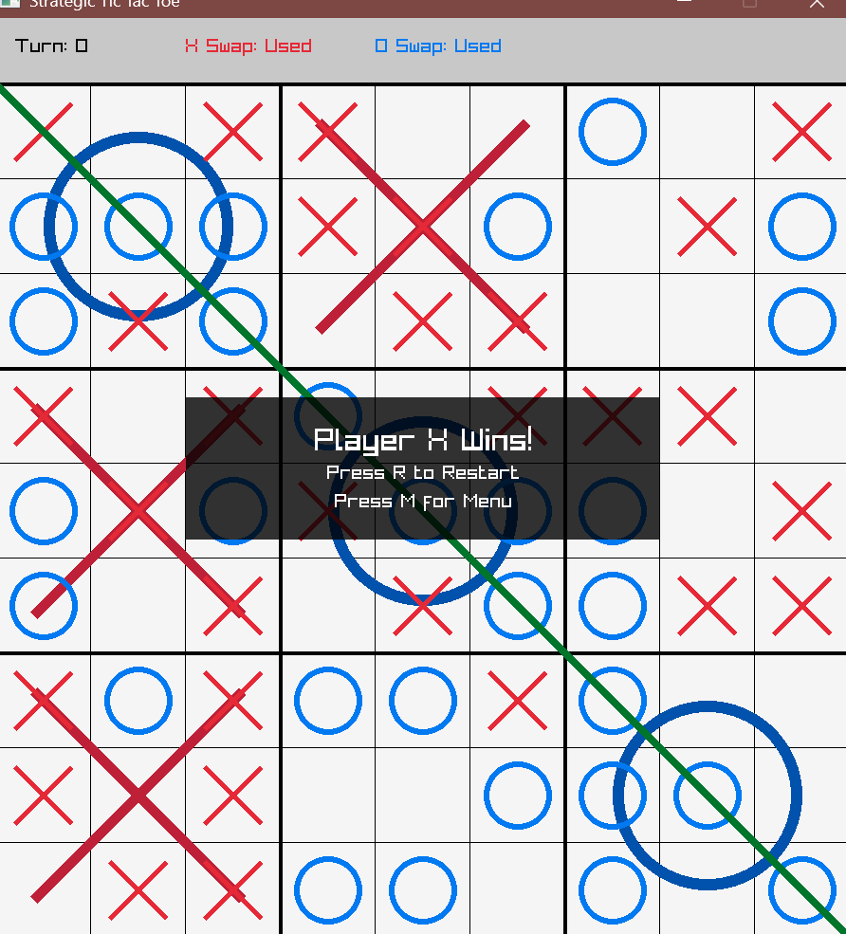

MISÈRE MODE
WHAT IS MISÈRE MODE?
MISÈRE TIC TAC TOE IS A VARIATION OF THE CLASSIC GAME WHERE THE RULES ARE THE SAME AS NORMAL TIC TAC TOE.
BUT THE OBJECTIVE IS REVERSED.
HOW IT WORKS:
PLAYERS TAKE TURNS NORMALLY.
AFTER EACH MOVE, THE PROGRAM CHECKS FOR 3 IN A ROW.
IF A PLAYER CREATES THREE SYMBOLS IN A ROW:
THAT PLAYER LOSES.
Opponent Is declared wInner.

Slide 8
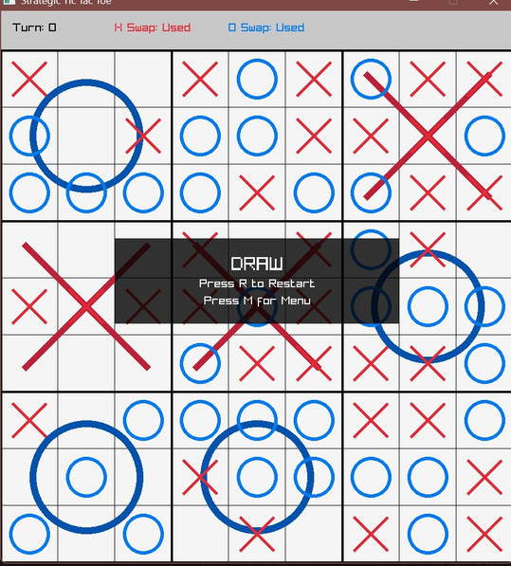
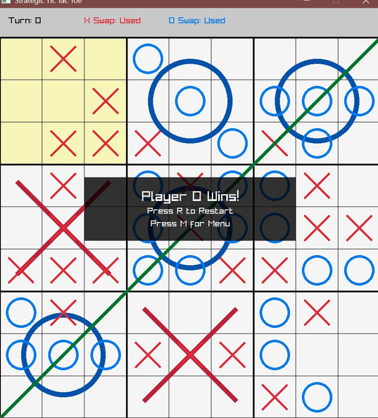

OUTPUT
THE PROGRAM FIRST DISPLAYS AN EMPTY 3×3 BOARD.
AFTER EACH MOVE, THE UPDATED BOARD IS SHOWN.
AT THE END, THE PROGRAM DISPLAYS:
"PLAYER X WINS"
OR "PLAYER O WINS"
OR "DRAW"

Slide 9
TOOLS AND CONCEPT USED
TOOLS USED:
C PROGRAMMING LANGUAGE
GCC / VS CODE COMPILER
WINDOWS OPERATING SYSTEM
CONCEPTS USED:
2D ARRAYS (TO REPRESENT THE GAME BOARD)
FUNCTIONS (TO ORGANIZE CODE)
LOOPS (FOR REPEATED EXECUTION)
IF-ELSE CONDITIONS (TO CHECK WINNING CONDITIONS)

Slide 10
Updated (from recommendatIons)
Added sound effects for move, wIn, Loss, Draw.
Pop up appears when It’s the player’s turn to swap to help them clearly understand
IMPROVED Menu Screen
Made InstructIons clearer

Slide 11
CONCLUSION & FUTURE SCOPE
THIS PROJECT HELPED IN UNDERSTANDING ARRAYS, LOOPS, AND CONDITIONAL STATEMENTS PRACTICALLY. IT IMPROVED LOGICAL THINKING AND PROGRAM STRUCTURING SKILLS.
FUTURE IMPROVEMENTS:
ADD COMPUTER (AI) OPPONENT.
ADD SCORE TRACKING SYSTEM.
CONVERT THE GAME INTO A GRAPHICAL VERSION.
DEVELOP A WEB-BASED VERSION OF THE GAME.

Slide 12
PRESENTED BY
1262251158 - AKANKSHA DANGE
1262251255 - ISHITA KALE
1262252018 - ESHITA UCHGAONKAR
1262253117 - ANVESHA JAIN
1262253453 - ADHITTE NAIR
1262254062 - ANANYA BHALE

